Slide 1

Rock-Paper-Scissors Game
Name:saisarath m
Organization:micro it

Slide 2
Rock-Paper-Scissors Game
Introduction
The Rock-Paper-Scissors Game is a timeless hand game usually played between two people. It is often used as a decision-making tool or simply for fun. In this project, we implement a digital version of the game, where the player competes against the computer. This project serves as a foundational programming exercise to learn decision-making, randomness, input handling, and user interaction.

Slide 3
Objective:
To develop an interactive Rock-Paper-Scissors game where a user can play against the computer using standard rules.

Slide 4
Description:
Rock-Paper-Scissors is a hand game between the user and the computer.
Choices:
Rock
Paper
Scissors

Slide 5
Rules:
Rock beats Scissors
Scissors beats Paper
Paper beats Rock
Same choice results in a draw

Slide 6
Tools & Technologies:
Programming Language: Python
Libraries: random (for computer choice), time (optional, for effects)

Slide 7
Logic Used:
Get the player's choice
Generate the computer's choice randomly
Compare both choices
Determine and display the result

Slide 8
Sample Python Code
import random
options = ['rock', 'paper', 'scissors’]
player_score = 0
computer_score = 0
while True:
user_choice = input("Enter rock, paper, or scissors (or 'exit' to quit): ").lower()
if user_choice == 'exit':
break
if user_choice not in options:
print("Invalid input, try again.")
continue
Code snippet is too large for slide. Refer to documentation or code file.

Slide 9
computer_choice = random.choice(options)
print(f"Computer chose: {computer_choice}")
if user_choice == computer_choice:
print("It's a tie!")
elif (user_choice == 'rock' and computer_choice == 'scissors') or \
(user_choice == 'scissors' and computer_choice == 'paper') or \
(user_choice == 'paper' and computer_choice == 'rock'):
print("You win!")
player_score += 1
else:
print("Computer wins!")
computer_score += 1
print(f"Score → You: {player_score} | Computer: {computer_score}\n")

Slide 10
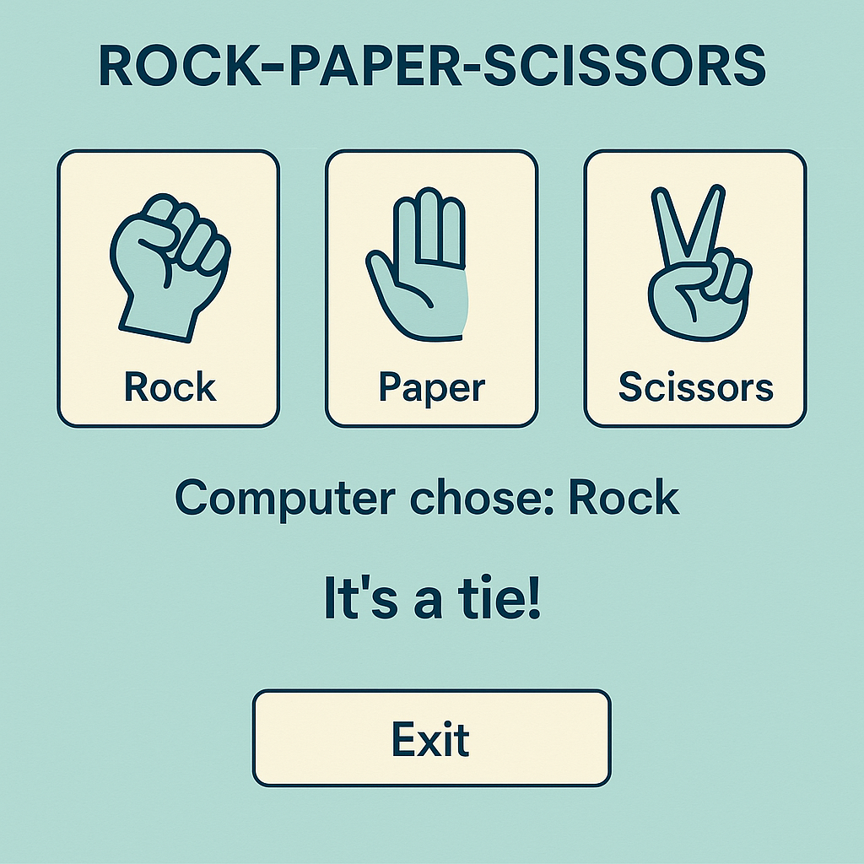
Sample Output
Enter Rock, Paper or Scissors: rock
Computer chose: scissors
You win!

Slide 11
Project Enhancements
Add a score counter
Add best-of-3 or best-of-5 game mode
GUI using Tkinter or Pygame
Sound effects and animations

Slide 12
Learning Outcomes
Understanding conditionals and loops
Working with user input and output
Using the random module
Writing clean and interactive code

